Slide 1
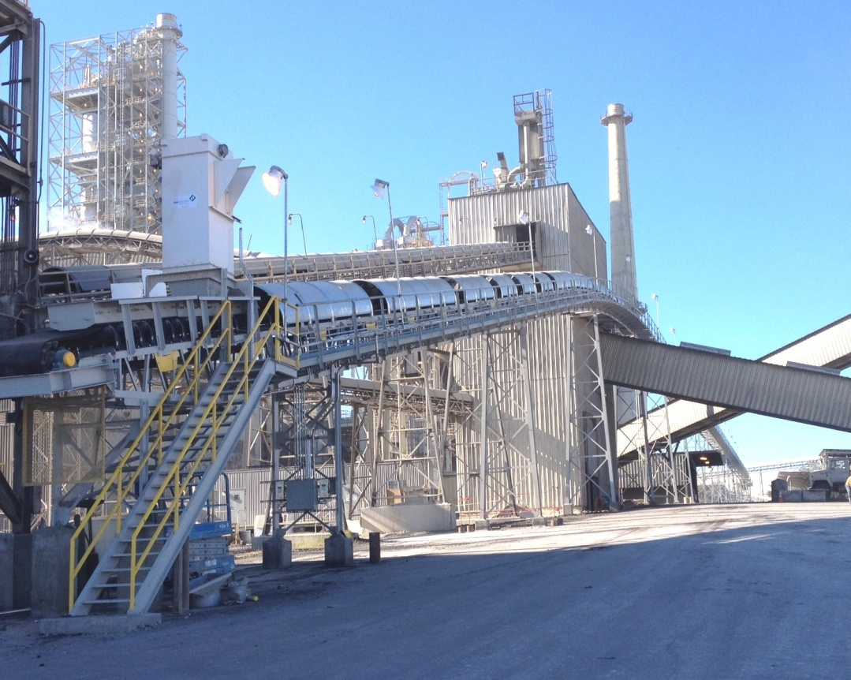
CEMENT PRODUCTION
Coal Conveyor
Project: TXI (Texas Industries, Inc), Hunter, TX
Coal Conveyor
Project P13121
Scope: Design and Install a new
Coal Conveyor
Coal Conveyor (1000 ft)
Fire Protection System
Electrical & Controls
Design
Electrical Installation
Start-Up Support

